Slide 1
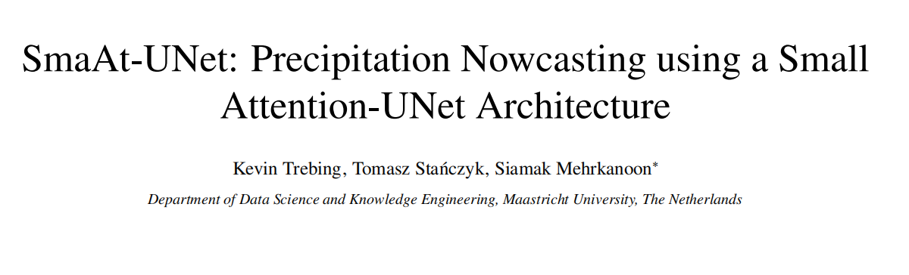
A downside of numerical weather prediction is that it is lacking the ability for short-term forecasts using the latest available information. By using a data-driven neural network approach it is possible to produce an accurate precipitation nowcast.
Propose SmaAt-UNet, an efficient convolutional neural networks-based on the well known UNet architecture equipped with attention modules and depthwise-separable convolutions.
Dataset: real life datasets using precipitation maps from the region of the Netharlands and binary images of cloud coverage of France
The experimental results show that in terms of prediction performance, the proposed model is comparable to other examined models while only using a quarter of the trainable parameters.

Slide 2
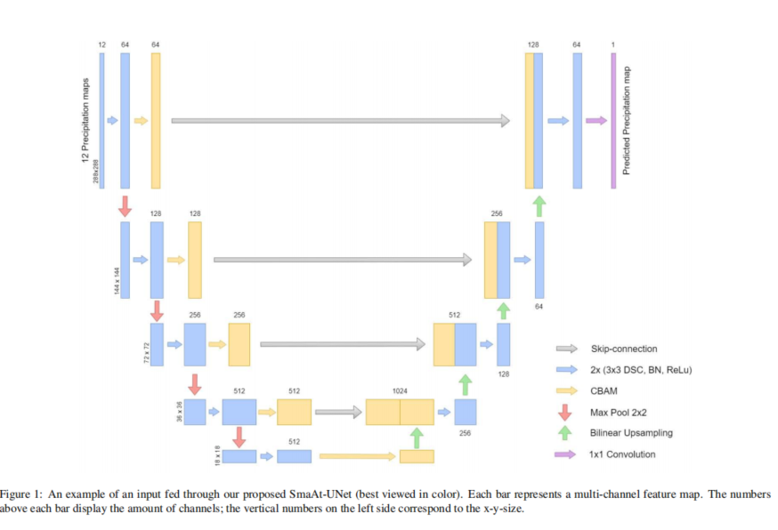

Slide 3
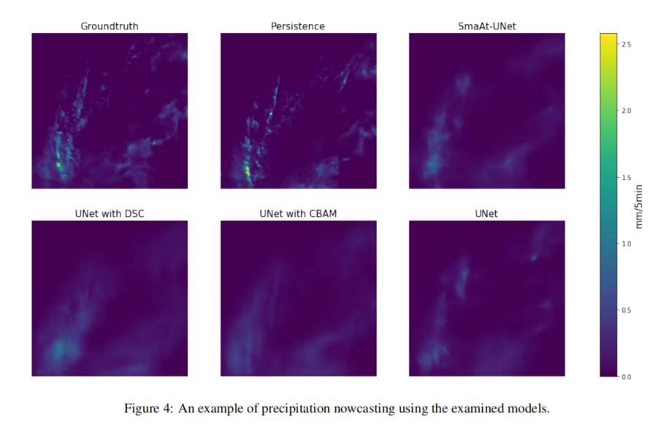
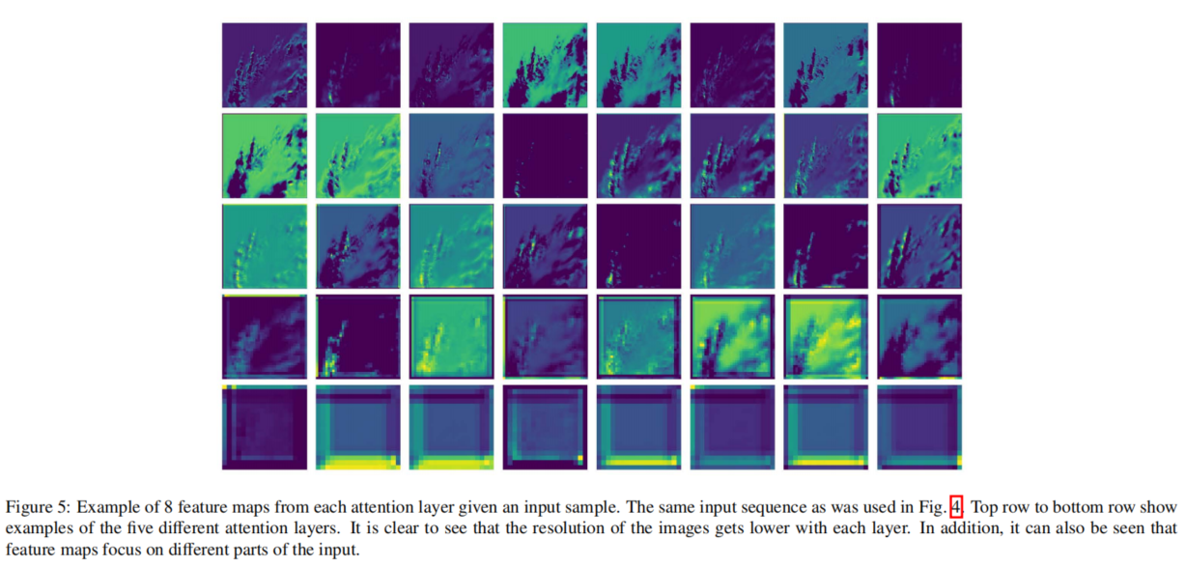

Slide 4
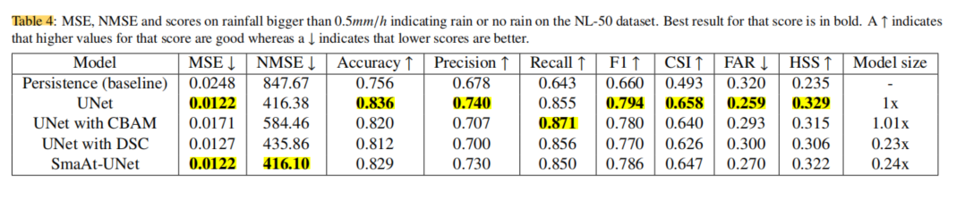
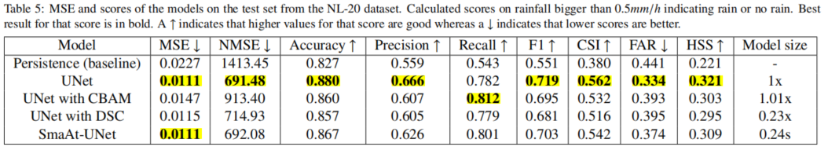

Slide 7
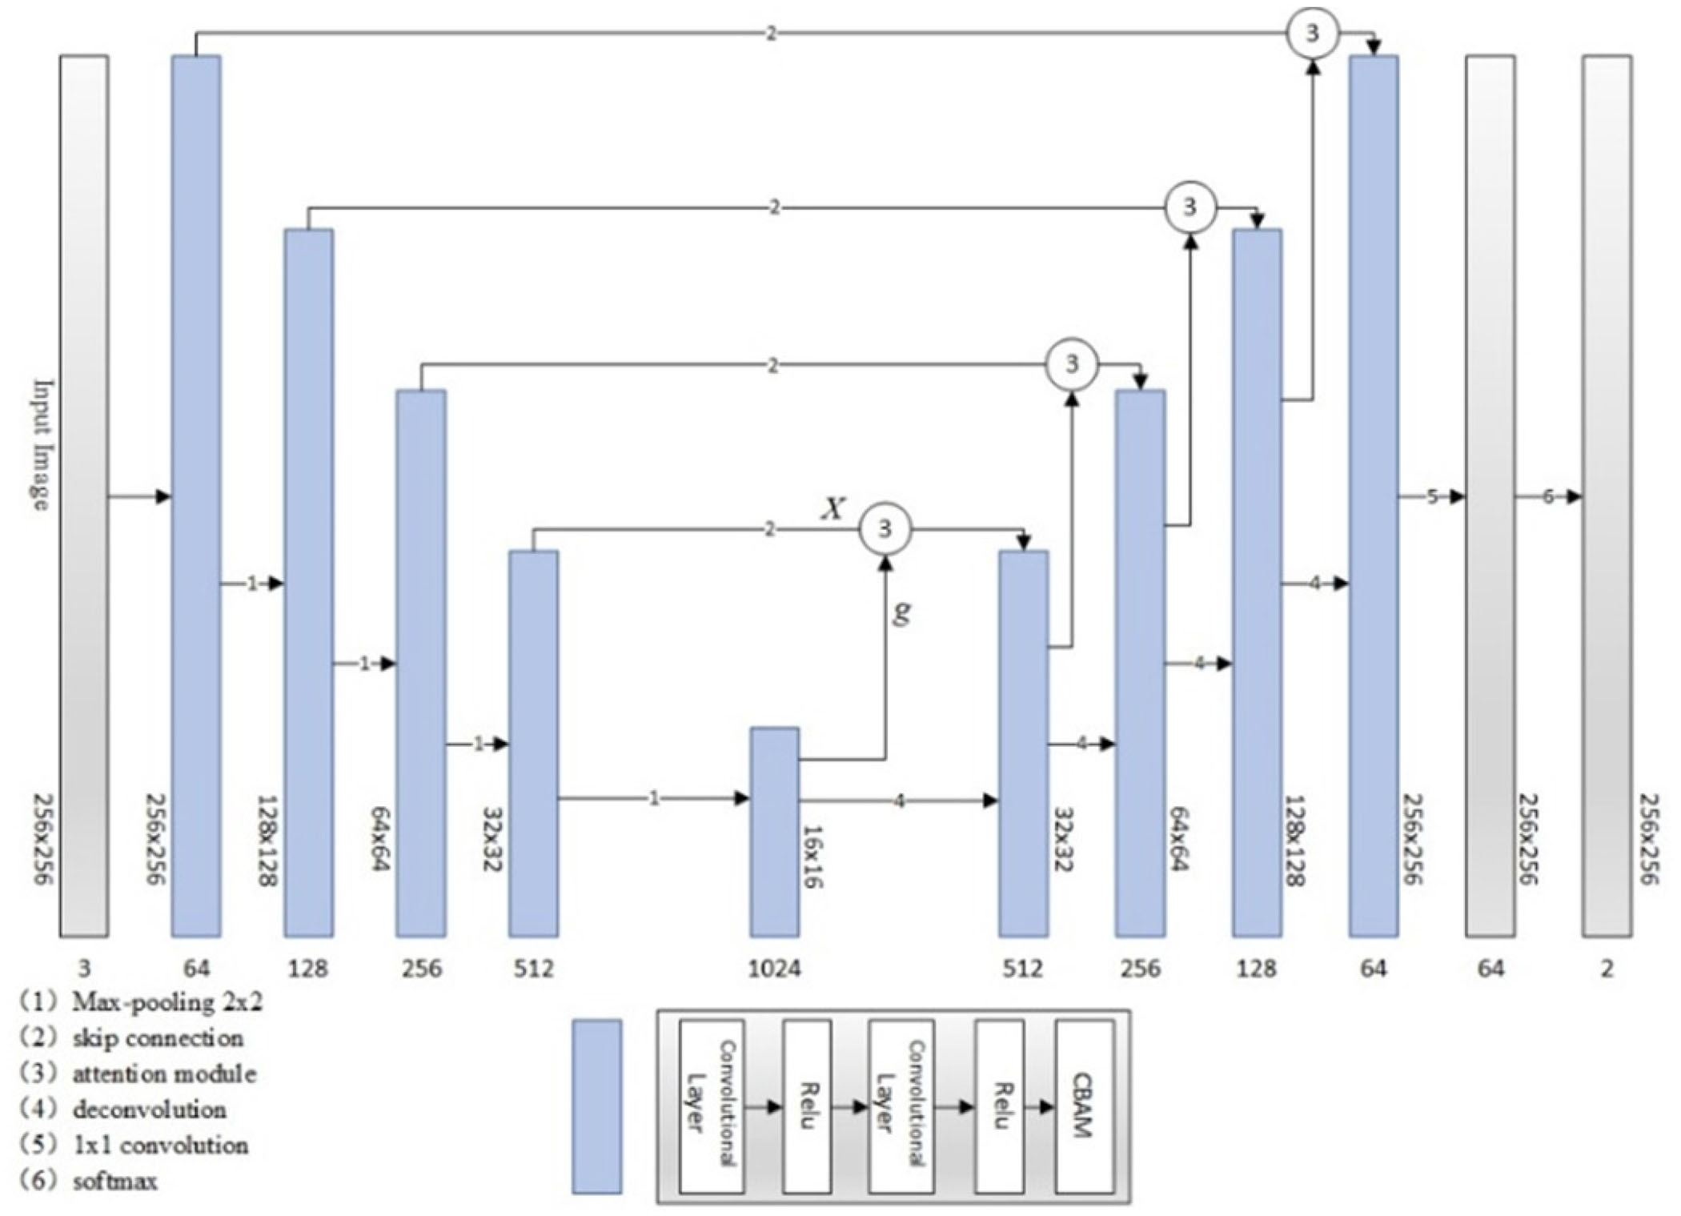
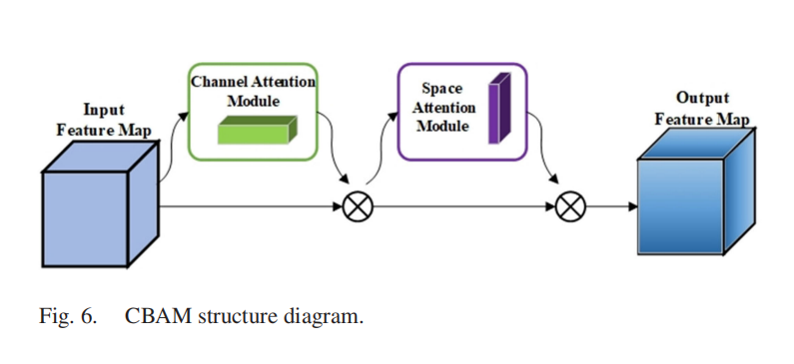
Fig. 5 UNet-CBAM structure

Slide 8
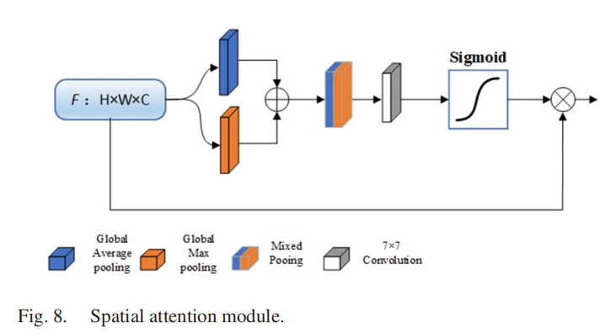
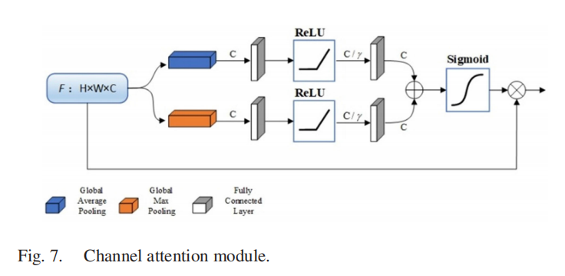
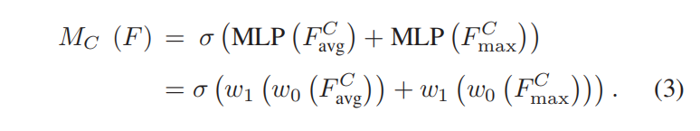
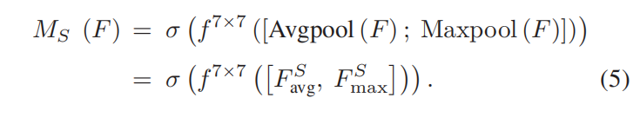



Slide 9
Key Differences
UNet: Baseline architecture for image segmentation with encoder-decoder and skip connections.
UNet with CBAM: Adds attention mechanisms (CBAM) to improve feature selection and focus on important parts of images.
UNet with DSC: Uses Depthwise Separable Convolutions to reduce model complexity and computational load, making the architecture more efficient.
SmaAt-UNet: Combines the benefits of both DSC and attention mechanisms, providing a lightweight, efficient architecture with improved focus on relevant features.

